Slide 1
Ruptura de Barragem Análise e Mapeamento
Jerry W. Webb, P.E., D.WRE
Engenheiro Hidrológico e Hidráulico Principal
Hydrology, Hydraulics & Coastal Community of Practice Leader
US Army Corps of Engineers, Sede
Jerry.w.webb@usace.army.mil
Oficina sobre Segurança de Barragens
Brasília, Brasil
20-24 maio 2013

Slide 2
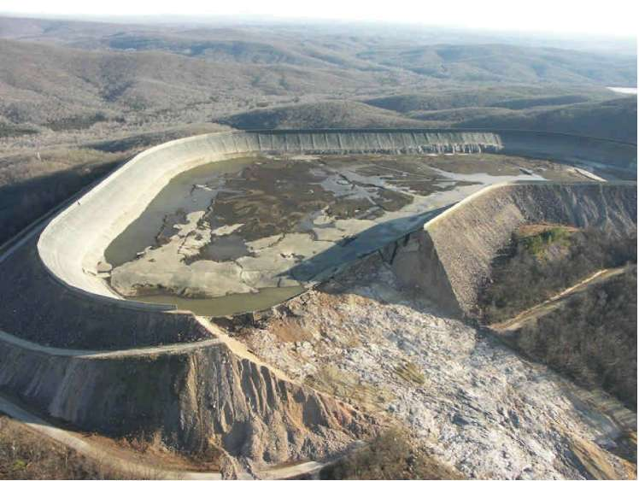
Conteúdo
Geral
Modelagem
Mapeamento
Notes:
General – Failure can be caused by a variety of problems. Geotech, structural, Manmade, Hydrologic,

Slide 3
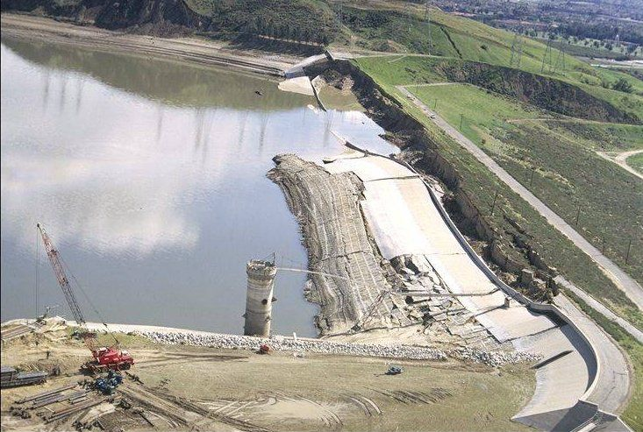
Problemas Geotécnicos
Notes:
Type of potential hazard

Slide 4
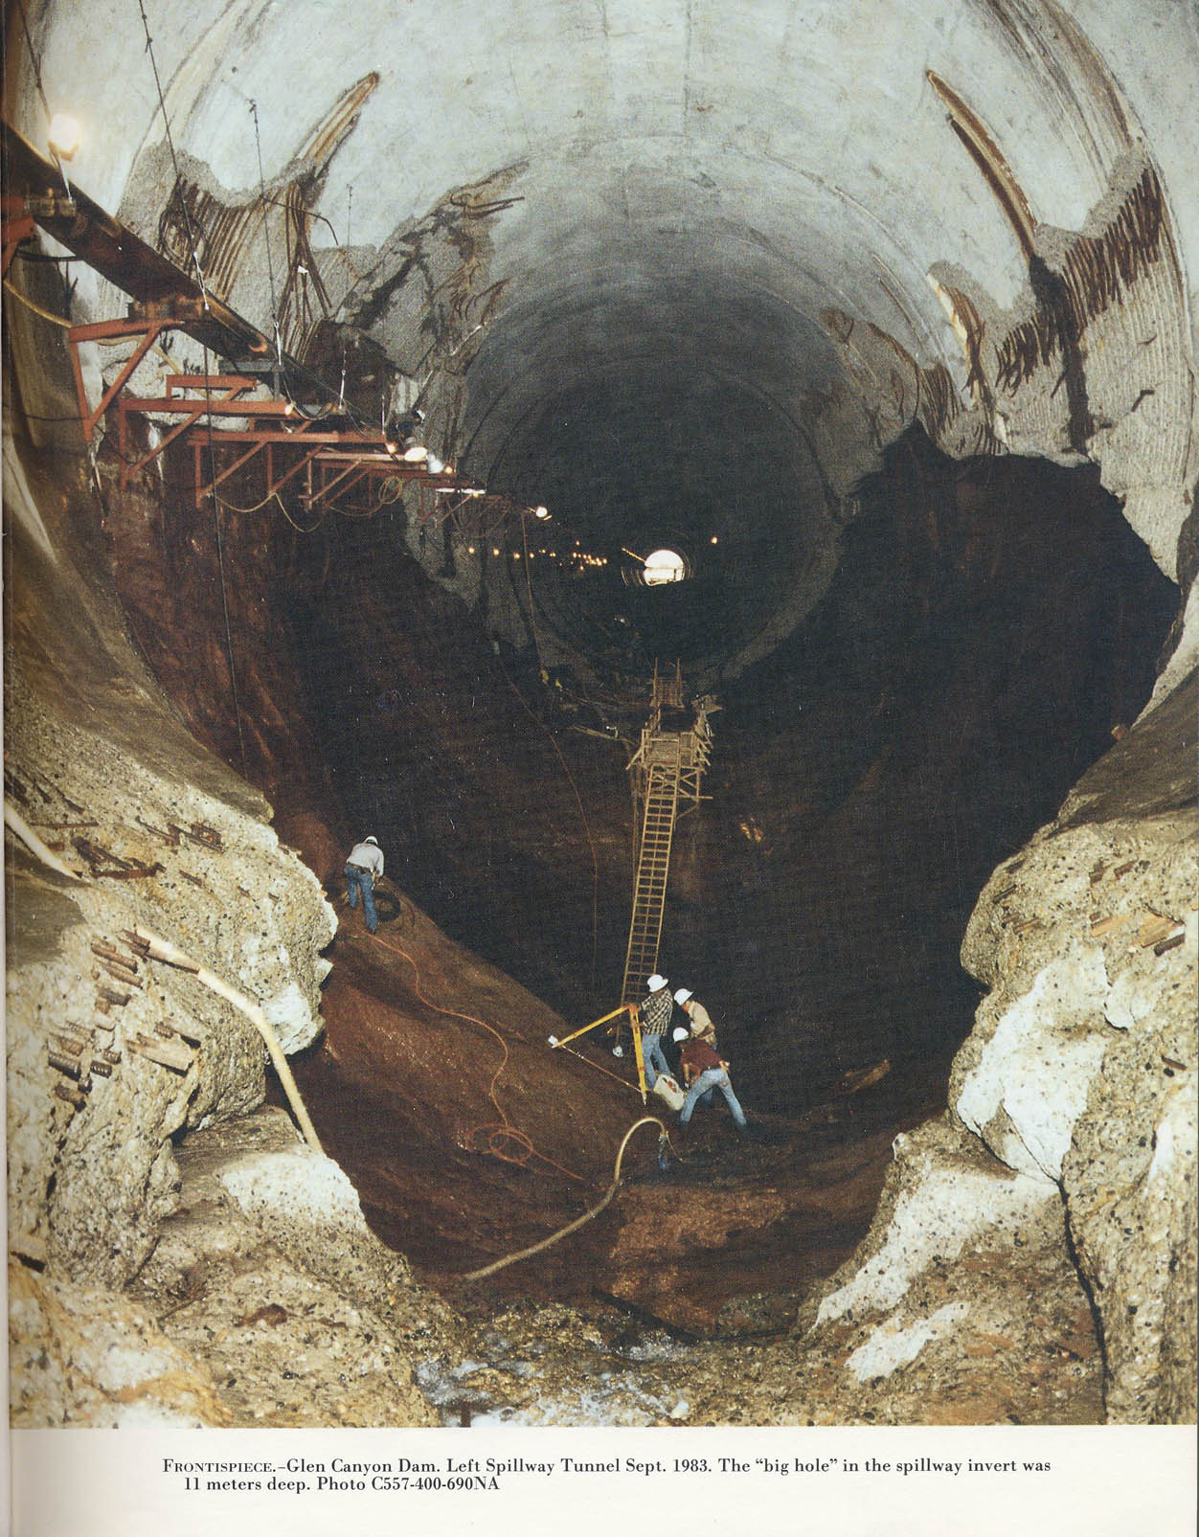
Vertedouro
Notes:
Glen Canyon Dam
The dam has two huge spillways, one on each side. These are 41 feet in diameter, and have a capacity of 104, 000 cubic feet per second each. There are 4 outlet valves connected to 8-foot outlet tubes designed to discharge water around the power plant. Water can also be released through a tunnel once used to divert water during construction of the dam.
This system was put to the test in 1983 when a late regional winter storm system increased the snow level by 200% of normal, then began to melt quickly. Lake Powell was already at a high level, so water needed to be released to make room for the heavy snow-melt. Even with the dam wide open, the lake continued to rise for weeks but was eventually controlled. Because of the high run-off that year, all the Colorado River dams released excess water causing some flooding downstream on the lower portions of the river.

Slide 5
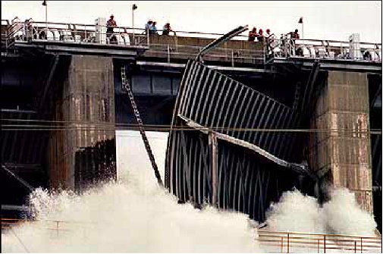
Falha Acidental
Notes:
Folsom Dam on the American River about 20 miles upstream of Sacramento. On July 17, 1995 a gate failed during testing. About 35,000 cfs was released through the broken gate into the American River. This was over 10 time the normal summer flow in the river. No deaths were reported.

Slide 6
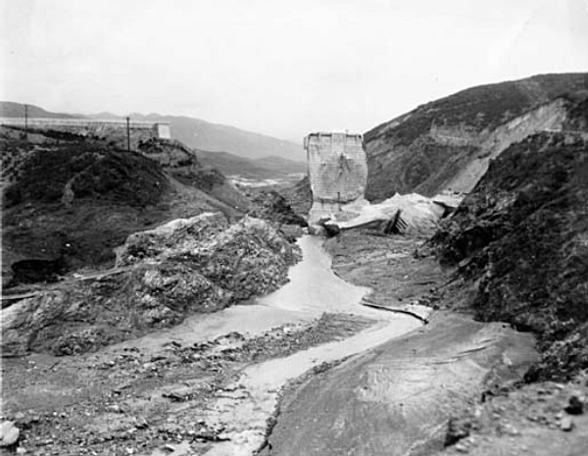
Ruptura Completa
Barragem St. Francis, CA
Johnstown, PA
Kaloko Dam, Kauai, HI
Barragem Teton
Notes:
Type of potential hazard
St Francis Dam failed in 1928 Dam. Designed by Mulholland. Over 100 died
Teton Dam failed June 5 1976. 11 Deaths
Johnstown, Pa failed May 1989. 2200 deaths
Kaloko Reservoir on Kauai, March 2006. 7 Dead

Slide 7
Modelagem de Falhas de Barragens
HEC-HMS (Hydrologic Engineering Centers Hydrologic Modeling System)
Modelo no Contexto da Bacia
HEC-RAS (Hydrologic Engineering Centers River Analysis System)
Roteamento Dinâmico
Captar as Implicações Hidráulicas da Falha
Planície de Inundação Modelo
Notes:
Dam failure can be modeled in RAS or HMS

Slide 8
Considerações a Jusante
HMS
Roteamento do Fluxo Hidrológico
Melhor para Taludes de Médio a Muito Inclinados
RAS
Roteamento Hidrodinâmico (Taludes planos a muito inclinados)
Possíveis problemas de estabilidade em rios muito inclinados
Gerar Planície de Inundação
Danos
Planejamento para Emergências
FERC
Notes:
Each of the programs have different routing capabilities. With HMS, routing within the model is accomplished with hydrologic modeling as opposed to dynamic modeling in RAS. HMS may be better if slopes are steep but if downstream tailwater impacts are important, RAS can automatically handle this situation.

Slide 9
HMS Conceito Geral
Calcular o hidrograma para um ponto a jusante do reservatório, supondo que houve uma ruptura na barragem.
Uma ruptura de barragem acontece dentro do contexto maior da bacia:
Condições prevalentes de solo, de canais de água e o reservatório, no início da simulação.
Condições meteorológicas antes, durante e logo depois do início da ruptura.
Notes:
The lecture is intended to review the Hydrologic Modeling System (HEC-HMS) users who have previous experience with the program. It briefly covers the basics of the program including how a project is organized, the program layout, main components, and modeling elements. More detail is provided on the subbasin and reach elements since these are key to computing inflow to a reservoir. Even more detail is provided for the reservoir element that is the focus of dam safety studies.

Slide 10
Elaboração Inicial do Modelo
Modelo de bacia com sub-bacias, braços e confluências.
Desvios e reservatórios com estruturas de saída funcionando normalmente.
Montar um ensaio de simulação e computá-lo para garantir que tudo esteja funcionando corretamente.
Calibrar o modelo, usando tempestades históricas, enfatizando a coincidência com grandes eventos.
Notes:
“reaches and junctions” -- ??
The initial model development proceedes in much the same was as the development of a hydrology model for general use. The watershed must be delineated and then the subbasins as well. Within HEC-HMS, subbasins, reaches, and junctions should be configured to represent the channel network. Engineered structures such as diversions and reservoirs must also be added. The normally operating features of diversions should be specified, such as physical dimensions of a lateral weir. Features of a reservoir must also be specified such as outlets, spillways, etc.
Create a simulation run and compute it to make sure all data is entered correctly. Next, the basic model must be calibrated. Calibration can proceed as for any other hydrology model. Collect precipitation data (and possibly snowmelt data) for several storms from the historical record. Where ever possible, collect observed flow data as well. Use several storm events to calibrate the loss rate, unit hydrograph, and baseflow parameters in the subbasins. Select appropriate routing methods in the reaches and calibrate the parameters. Try to verify that the configuration of any diversions or reservoirs reproduces the observed operations.

Slide 11
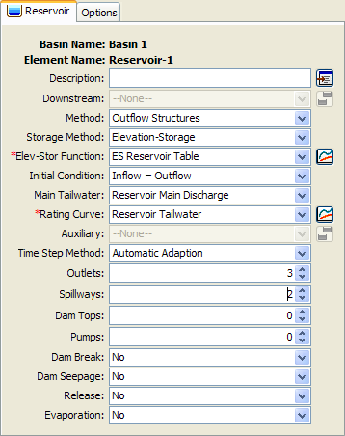
Dados Gerais do Reservatório
Método de roteamento das estruturas de saída, com curva de área-elevação ou elevação-armazenamento.
Incluir vertedouros, saídas, transbordamentos ou outras estruturas que operam normalmente.
Modelos de múltiplas bacias com todos os elementos e dados iguais, inclusive o reservatório base de referência.
Modelo de bacia separado para cada alternativa.
Alternativas: sem ruptura, vários cenários de ruptura.
Notes:
Because we are focusing on a dam break analysis, the focus of much of our efforts after calibration will be the reservoir element. We must use the “Outflow Structures” routing method in order to use the dam break simulation tool. This method requires that the storage capacity of the reservoir be described using an elevation-area or elevation-storage curve. Be sure that the curve extends from the bottom (including any dead storage) past the top of the dam. It is not enough to bring the curve up to the emergency spillway elevation. The curve will need to extend up to the highest surcharge elevation that will be reached during a simulation.
Add structures to the reservoir as appropriate. Likely you will need outlets and spillways (with or without gates) and possibly dam tops or pumps. The physical properties for each structure must be entered. The best place to find this information is the reservoir regulation manual.
Begin with the calibrated basin model, including the reservoir with all normally operating structures. Usually we will make several copies of the basin model. Each one will have a dam break added to it, with slightly different breach parameters in each model. The results obtained with each different basin model will represent different break scenarios.

Slide 12
Suposições sobre a Ruptura de Barragem
O espelho d’água atrás da barragem está nivelado antes, durante e depois da ruptura.
A velocidade horizontal no lago é próximo a zero.
A carga total é igual à carga por gravidade.
A descarga da ruptura entra no canal a jusante.
Implicações:
O suprimento de água à ruptura pode ser superestimado, especialmente se o reservatório é longo e estreito, ou se a ruptura se dá rapidamente.
A velocidade da água através da ruptura pode ser subestimada, levando a subestimar a vazão da ruptura.
É melhor usar:
Reservatórios com grande capacidade comparada ao volume de influxo.
Reservatórios que não são longos e estreitos.
Notes:
A number of assumptions are made in the dam break module included in the HEC-HMS reservoir element. The most significant is that the water surface behind the dam is assumed to be level before, during, and after the breach forms. This is generally only true for small reservoirs. In large reservoirs, water cannot reach the breach fast enough to maintain a level surface and instead a sloped surface forms.
Along with the level pool elevation is the assumption of nearly zero horizontal velocity. This implies the next assumption which is that the total head of the water in the pool is equal to the gravity (or elevation) head. In reality, if the pool surface is sloped then horizontal velocity will be greater than zero and the total head will include both a gravity and velocity component.
All discharge from the breach is assumed to enter the downstream channel. Some reservoirs may be such that when a dam or dike fails, the discharge spreads out over the land surface until it eventually enters a stream channel. Situations such as these require a different software tool.
Overall these assumptions mean that HEC-HMS is bested suited to simulating reservoirs where a sloping water surface does not develop. Also, that the breach opens at a rate slow enough to match the draw down capacity of the reservoir.

Slide 13
Parâmetros de Ruptura
Modo galgamento ou erosão tubular
Apenas a erosão tubular exige parâmetros adicionais:
Elevação da erosão (onde se abre o furo da erosão)
Coeficiente da erosão (para o fluxo do orifício através do furo da erosão)
Definir o tamanho final da ruptura:
Elevação do topo (elevação no topo da ruptura).
Elevação no fundo (elevação no fundo da ruptura).
Largura do fundo (largura no fundo da ruptura)
Inclinações dos lados esquerdo/direito (inclinações laterais da ruptura ao se abrir na face da barragem)
Definir o tempo de progressão:
Quanto tempo demora para a ruptura crescer do início até o tamanho final.
Usar o tempo “crítico”, que começa com uma saída significativa e termina quando a ruptura para de crescer significativamente.
O reservatório ainda pode conter um grande volume de água quando a ruptura para de crescer.
Notes:
The main parameter for a dam break is whether the breach forms as an open-top trapezoid due to overtopping, or like a conduit due to piping. HEC-HMS does not physically model either development mode. Instead parameters from external sources are entered to describe the shape of the breach as it opens and the rate at which it opens.
The ultimate size of the breach must be described. This is the size that is expected when for all practical purposed the breach has stopped growing. Remember that the breach may stop growing because the entire dam is eroded or because the reservoir is drained and there is no more water to erode the dam. Both failure methods require the top elevation, usually taken as the top of the dam. The bottom elevation is the point where the dam will stop eroding, usually either bedrock or the bottom of the reservoir pool. The width at the bottom elevation must also be specified. Finally the left and right side slopes must be entered; they are not required to be equal to each other.
After defining the maximum size of the dam break, it is necessary to define when the break initiates and how long it takes for the breach to open to the ultimate size. The development time defines the length of time from first meaningful flow through the breach, to reaching the ultimate size. Often dams begin to fail and evidence of the impending failure is visible. This time should not be included in the development time; only include the time after flow actually begins through the breach.
If the bottom elevation of the breach is above the bottom of the reservoir, then there may be dead storage that does not leave the reservoir.

Slide 14
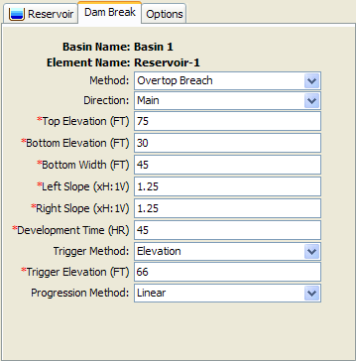
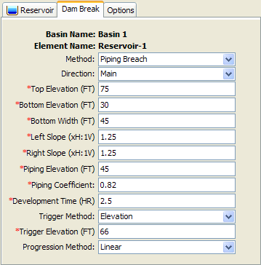
Parâmetros de Ruptura
Notes:
Picture of the dam break editor in HEC-HMS. Navigate to the editor by clicking on the reservoir element in the Watershed Explorer or in the Basin Map. Next expand the reservoir node in the Watershed Explorer and click on the Dam Break sub-node. Depending on the method (overtop or piping) the appropriate data entry fields will be shown.

Slide 15
Início da Ruptura
Opção 1) Duração na elevação: a ruptura começa quando a elevação do espelho do reservatório ultrapassa uma elevação especificada durante um determinado intervalo de tempo
Elevação de desencadeamento.
Tempo determinado.
(Opção 2) Elevação: a ruptura começa assim que a elevação do espelho do reservatório alcança uma elevação especificada.
Elevação de desencadeamento.
(Opção 3) Hora específica: a ruptura começa a uma data e hora, independente da elevação do espelho.
Data de desencadeamento.
Horário de desencadeamento.
Notes:
At this point, you have defined the ultimate size of the breach and the length of time necessary for the breach to develop. It is necessary to define when the breach will initiate during the simulation. One option is to specify the length of time the reservoir pool elevation must remain above some threshold. This information may be the result of a detailed geotechnical investigation into the dam itself. A second option is to specify a pool elevation; the breach begins to open as soon as the elevation is reached. The final option is a specific time during the simulation regardless of the pool elevation.
The second option is used frequently during a PMF study. A simulation will be performed without dam break. Use this simulation to determine the maximum pool elevation reached. This elevation can then be used as the trigger elevation in order to maximize the volume of water that contributes to the dam break. The third option can be used to try and match historic data of an actual dam failure, or to consider what-if scenarios during forecasting operations.

Slide 16
Progressão da Ruptura
A progressão define a taxa de crescimento da ruptura do tamanho inicial até o tamanho final.
(Opção 1) Linear.
A ruptura cresce a uma só taxa uniforme, enquanto dura seu tempo de progressão.
(Opção 2) Onda senoidal.
A ruptura cresce a uma taxa variável defendida pelo primeiro quarto de uma onda senoidal.
(Opção 3) Curva do usuário.
Especifique uma curva que dê o percentual do crescimento da ruptura versus o percentual da duração do tempo da progressão.
O tempo da progressão aumenta de modo linear.
Notes:
The development time of the breach describes how long it takes for the full breach to form. The breach initiation controls when the breach starts to form. Progression describes how the rate at which the breach grows during the development time.
The simplest progression is linear and means that the breach grows at a uniform rate. Consider a development time of 2 hours and a control specifications time interval of 15 minutes. The breach will develop over 8 time steps. For each time step, the breach will grow by 1/8 of the ultimate breach opening.
The sine wave progression results in a breach that initially grows very quickly then slows down towards the end of the development time. You can define your own growth pattern using a percentage curve in the paired data manager. That curve defines the percentage of breach growth as a percentage of the development time.

Slide 17
Condição da Água a Jusante
Em geral, os efeitos da submersão devem ser incluídos ao computar a vazão através de uma ruptura.
(Opção 1) Nenhum.
Válida apenas se o fundo da ruptura fica sempre acima do espelho d’água a jusante.
Há quase sempre algum efeito causado pela água a jusante, especialmente quando a ruptura alcança sua dimensão final.
(Opção 2) Vazão da saída do reservatório mais a curva de descarga.
Geralmente válida quando o reservatório é a única fonte de vazão rumo à água a jusante.
(Opção 3) Vazão a jusante mais a curva de descarga.
Necessária quando outros elementos contribuem vazão à água a jusante.
(Opção 4) Estágio especificado.
Apenas quando a liberação do reservatório é pequena comparada à vazão total a jusante, e a vazão a jusante é conhecido.
Normalmente não se aplica, em cenários de ruptura de barragens.
Notes:
Tailwater condition is used to describe the depth of water immediately downstream of the dam and affecting how much water flows through the breach. The affect of tailwater is to reduce the flow through the breach, since physically the flow is partially blocked by the presence of dowstream water. For a high dam, it may be possible that the bottom of the breach always remains above the tailwater. However, this situation is very rare. There are virtually no cases where the modeling of tailwater can be ignored.
The most common way to model tailwater is to compute the depth using the reservoir outflow and a rating curve. The curve could be developed using stream measurements. However, the outflow during a dam failure will be significantly larger than previously observed flow. You should consider using a hydraulics model to extend the rating curve. HEC-HMS will not extend the curve for you; you must specify it to the maximum flow that will be discharging from the reservoir.
In some cases there are contributions to the tailwater from other locations besides the reservoir. In these cases the reservoir flow must be added to the additional inflow before applying the rating curve. This might be the case if the reservoir discharges into a river as a lateral inflow.
In some rare cases, you may be able to use a specified tailwater stage using a time-series gage. However, this can only be done if the reservoir discharge will have a minimal affect on the tailwater stage. This is rarely the case in dam failure studies.

Slide 18
Limitações
Reservatórios longos e estreitos que adquirirão um espelho d’água não nivelado depois do início da ruptura.
Falhas nas quais a descarga da ruptura é difusa, em vez de para um canal bem definido.
Ramificações a jusante com pequenas inclinações e/ou uma geometria do canal que levem a um roteamento complicado.
Galgamento e falhas de diques.
Águas de remanso em afluentes.
As estimativas de estágios geralmente não são confiáveis o suficiente para alimentar o mapeamento de planícies de inundação.
Notes:
There are several limitations to the dam break modeling in HEC-HMS that must be considered. If any of these are a factor in a project, then it may be necessary to consider a hydraulic model.
Reservoirs with a long, narrow pool usually develop a sloping water surface during a dam breach. The assumptions in HEC-HMS are for a level pool. Breaks that develop faster than the reservoir can draw down may also be a problem; these situations also lead to sloping water surface in the pool. In both of these cases, the HEC-RAS program can be used since it considers a non-level pool in the reservoir.
Dam breaks are usually envisioned to happen on dams across a river. However, some reservoirs are situated in relatively flat topography and have one or more dikes to contain the storage pool. This dikes are not immune from failure and should be evaluated. Often, failure of a dike leads to discharge that is diffuse across the land surface. This situation may require a two-dimensional hydraulics model.
You may not be able to use HEC-HMS if the downstream reaches lead to complicated routing. For example, high stages resulting from the dam break may overtop levees; the program does not explicitly represent levees. Also, the program cannot model backwater and significant volume may be temporarily stored in tributaries.
The stage estimates from downstream routing within HEC-HMS are generally not good enough for floodplain mapping. If you require floodplain maps then you will need to do the downstream routing using HEC-RAS.

Slide 19
Análise da Ruptura de Barragens no HEC-RAS
Modos de Falha
Galgamento e erosão tubular
Início da Falha Baseado em:
Estágio
Tempo simulado
Estágio + duração, e estágio de início imediato
Progressão da Ruptura
Linear ou não linear (especificado pelo usuário)
Nova opção simplificada de ruptura física
Dados Fornecidos pelo Usuário:
Largura máxima do fundo da ruptura, elevação final do fundo, tempo de progressão, modo e valor do início da falha, método de progressão do crescimento, inclinações das laterais direito e esquerdo.
Notes:
HEC-RAS can be used to model both overtopping as well as piping failure breaches for earthen dams. Additionally, the more instantaneous type of failures of concrete dams (generally occurring from earthquakes) can also be modeled. The resulting flood wave is routed downstream using the unsteady flow equations. Inundation mapping of the resulting flood can be done with the HEC-GeoRAS program (companion product to HEC-RAS) when GIS data (terrain data) are available.

Slide 20
Locais de Rupturas no HEC-RAS
Reservatório
(Área armaz.)
Elev.
vs.
Vol.
Barragem
(Estrutura em linha)
Dique
(Estrutura lateral)
Notes:
The formation of a breach can be simulated in two types of structures: inline and lateral. The parameters and hydraulic computations for the breaches are the same. A reservoir is usually modeled as “inline”; that is, its geometry is described with cross sections. This allows dynamic routing of the flood wave through the reservoir.
Alternatively, the reservoir can be described as a “storage area” for which the geometry is described by an elevation-volume relationship. Level-pool hydrologic routing within the reservoir is done for this situation. (See Goodell¹)
There must be at least two cross sections between the storage area and the dam. The first cross section is associated with the storage area and the second is associated with the inline structure that represents the dam. These two cross sections should be large, “reservoir-sized” cross sections.
A lateral structure may be a levee that overtops and does not fail, or possibly fails (depending on user input data). The levee is connected to a neighboring reach or storage area.
¹Goodell, Christopher R. “Dam Break Modeling for Tandem Reservoirs – a Case Study using HEC-RAS and HEC-HMS,” Presented at the ASCE World Water & Environmental Resources Congress 2005, EWRI, Anchorage, AK, 15-19 May 2005.

Slide 21
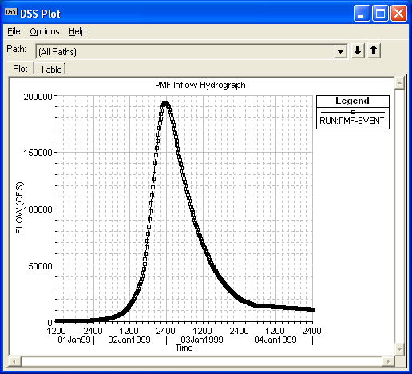
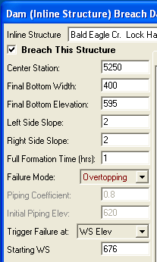
Eventos de Condições Extremas
Modelado com Modos de Falha “Galgamento” ou “Erosão Interna” no HEC-RAS
Eventos extremos de enchentes induzidas por chuva
“PMF” (máximo provável)
100, 200, 500 anos, etc…
Falha de barragem a montante
Deslizamento, mega-tsunami
Barragem Vajont, Itália
Notes:
Most dam failures occur during some type of event that has caused a significant rise in the water surface elevation behind the dam. When performing an analysis of a dam for evaluation of the risks and uncertainties associated with the dams failure, generally extreme events, such as the PMF are analyzed. If the Dam is considered to be a “High Hazard” dam, meaning there is a population at risk downstream if the dam were to fail, then the PMF is considered to be the design event for the dam. If the dam is not considered to be a “High Hazard” dam, then often a smaller event is considered to be the design event, such as ½ the PMF, or even lower depending on the type and location of the dam.
Other types of events can also cause dam failures, such as the failure of an upstream dam, or a landslide that occurs above the dam. It is also good to look at other lesser events, such as the 100 year event, which may still be a very significant event for many dams.

Slide 22
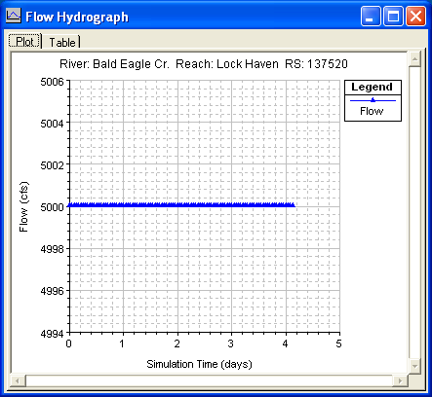
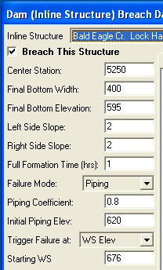
Eventos de um Dia Ensolarado
Modelado com Modos de Falha “Galgamento” ou “Erosão Interna” no HEC-RAS
Falha de ombreira ou de aterro
Barragem Teton
Mal funcionamento de saída
Comporta trava em posição fechada
Detritos
Deslizamentos
Aterro
Reservatório
Terremotos
Remoção planejada
Atos de guerra / terrorismo
Notes:
Many Dams have also failed while there was no significant hydrologic event occurring. These are called “Sunny Day” failures. Generally, when we think of Sunny Day Breach events, we think of piping failures such as occurred at Teton Dam. These typically begin with small leaks through the embankment, usually because of poor design/placement of soils. The leaks quickly erode material on the downstream face of the dam. The rate of breach development can be alarming as more and more soil is eroded from within the dam. Finally the crest of the dam slumps into the void, creating a wedge –shaped opening n the embankment. Sunny Day events are usually not associated with a particular flood event, although the increase in pool elevation resulting from an incoming flood wave could produce enough head on a weak point in the dam to induce piping. Other sunny day events include embankment slides, earthquakes (liquefaction, crest slumping, uplift), planned removal and demolition, and acts of war.

Slide 23
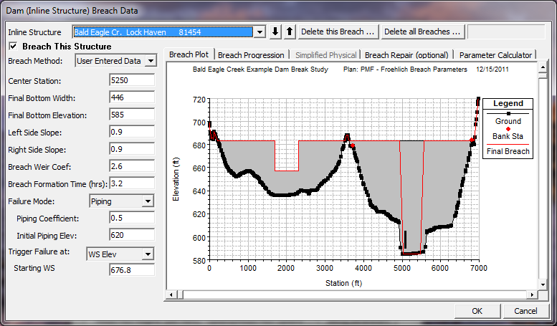
Dados sobre Ruptura de Barragem
Notes:
Center Station - This field is used to enter the cross section stationing of the centerline of the breach.
Final Bottom Width - Bottom width of the breach when it has reached its maximum size.
Final Bottom Elevation - Bottom elevation of the breach when it has reached its maximum size.
Left Side Slope - Left side slope for the trapezoid that will represent the final breach shape. Side slopes are entered in values representing the horizontal to vertical ratio.
Right Side Slope - Right side slope for the trapezoid that will represent the final breach shape. Side slopes are entered in values representing the horizontal to vertical ratio.
Breach Weir Coefficient –Weir coefficient used for overtopping (weir) flow in the breach area.
Failure Mode - This option allows the user to choose between two different failure modes, an Overtopping failure and a Piping failure.
Piping Coefficient - If a piping failure mode is selected, the user must enter a piping coefficient.
Initial Piping Elev. - If a piping failure mode is selected, the user must enter an initial piping elevation.
Trigger Failure At - This field is used to select one of two trigger methods for initiating the breach. The two trigger methods are a water surface elevation or a specific time and date.
Starting WS - If the user selects water surface elevation for the failure trigger mode, then this field must be entered. This field represents the water surface elevation at which the breach should begin to occur.
Start Date - If the user selects a starting date and time as the failure trigger mode, then this field must be entered. This field is used to enter the date at which the breach will begin to occur.
Start Time - If the user selects a starting date and time as the failure trigger mode, then this field must be entered. This field is used to enter the time at which the breach will begin to occur.

Slide 24
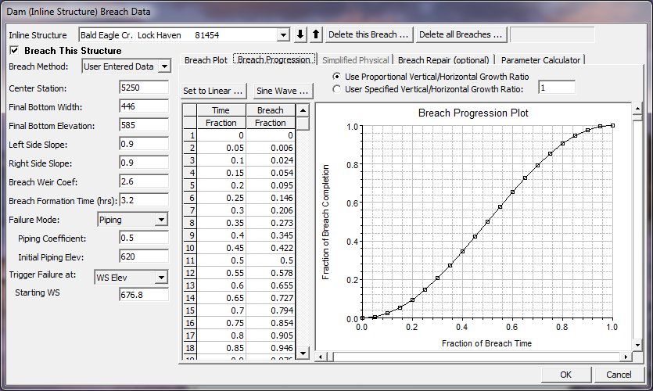
Progressão de Ruptura Não-Linear
Notes:
By clicking on the Breach Progression button, the above editor will be shown. By default, the breach growth is assumed to be linear from start to maximum size (Full Formation Time). However, a non-linear breach growth curve can be entered. This is done by entering a Time Fraction (from zero to 1.0) and a Breach Fraction (from zero to 1.0). The user-entered data is plotted in the graphic next to the table. The breach progression curve is then used during the breach formation time to adjust the growth rate of the breach.
In addition to adjusting the curve in order to have a more realistic breach growth, the curve can sometimes be used in order to improve stability. If the program is having stability problems during part of the breach growth, the rate of growth during that time can be reduced by adjusting the curve.

Slide 25
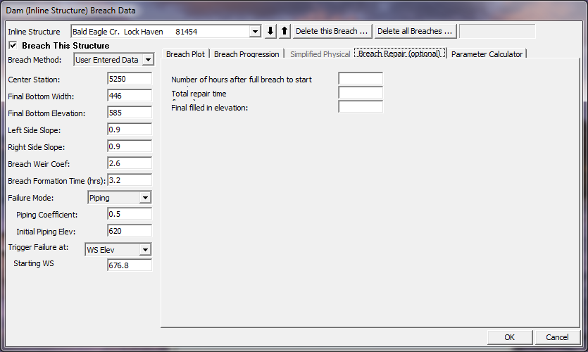
Opção de Conserto de Ruptura
Notes:
This option allows the user to have the breach fill back in during a simulation. This would most often be used for levee breaches, but could also be used for a dam breach if the user were running a long term simulation or if it was assumed that some effort would be put in place to fill a breach back in during a failure.
The Breach Repair Option requires the user to enter three pieces of information:
Number of hours after full breach to start repair: This field is used to enter the amount of time (in hours) it takes to start the repair process after the breach has occurred.
Total repair time (hours): This field is used to enter the total amount of time that it will take to perform the breach repair, in hours.
Final filled in elevation: This field is used to enter the top elevation of the final repaired breach.

Slide 26
Produto do Modelo
Corte transversal, perfil e plotagem XYZ
Hidrogramas de estágio e vazão
Produto tabular
Plotagem de perfis gerais (velocidade)
Exportar resultados para SIG
Notes:
Several plots and tables are available for evaluating the results of a dam break analysis within HEC-RAS. Graphics include cross section, profile, and 3 dimensional plots, all of which can be animated on a time step by time step basis in order to visualize the propagation of the flood wave. Hydrographs can be viewed at any location for which the user requested hydrograph output. Additionally the user can view Tabular output, general profile output, and export the results to the GIS for Inundation Mapping.

Slide 27
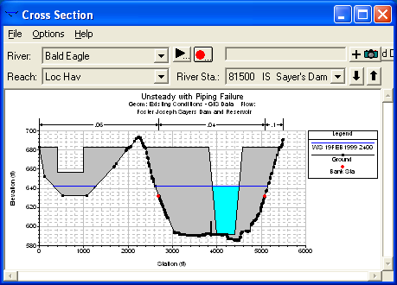
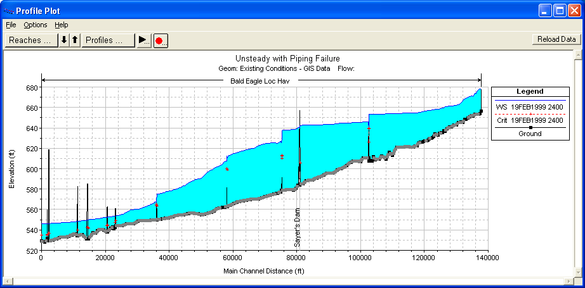
Corte Transversal e Plotagem de Perfis
Notes:
An example cross-section plot of a dam while it is breaching is shown in the Figure above. Additionally, the corresponding water surface profile for the same instance in time is shown in the profile plot above.

Slide 28
Exemplo de Animação de Ruptura de Barragem
Notes:
Under the animation option in HEC-RAS, an animation of the profile plot or the cross section plot can be written out as an AVI.

Slide 29
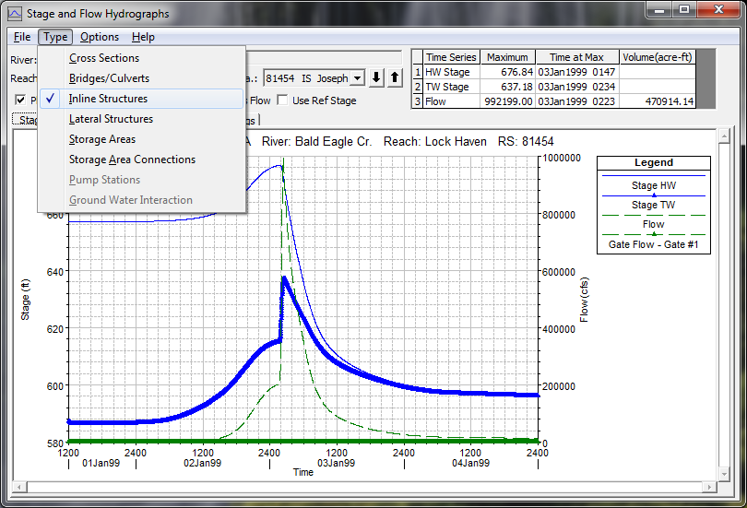
Hidrogramas de Estágio e Vazão
Notes:
Stage and flow hydrograph plots can also be viewed for normal cross section locations, as well as bridges/Culverts and the Inline Structure itself. Shown above is an example plot of the Stage and Flow Hydrographs for a dam )Inline Structure). Note that Peak flow, stage, and volume statistics at the top of the plot.

Slide 30
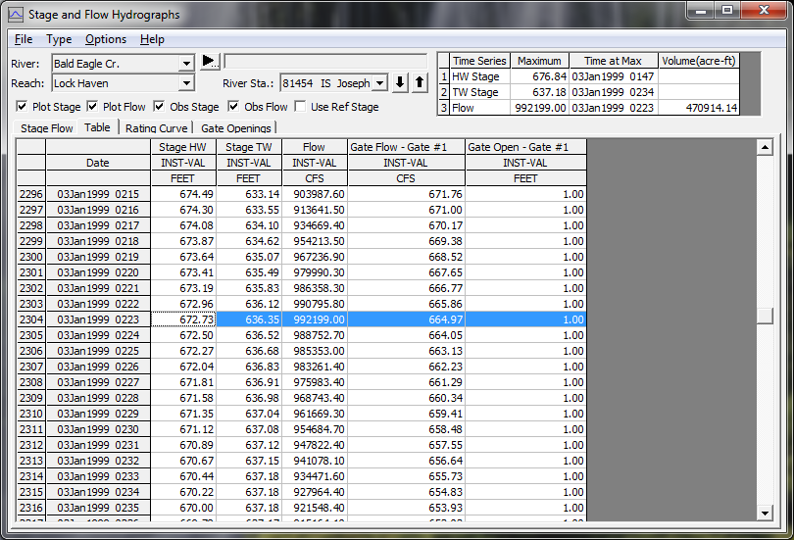
Produto Tabular: Séries Históricas
Notes:
A tabular view of the hydrographs on a Stage and Flow plot can also be viewed by simply pressing the Table tab on the window.

Slide 31
Questões para a Modelagem de Rupturas de Barragens
Parâmetros da Ruptura e da Propagação das Ondas de Cheia
Intervalo Temporal na Computação
Espaçamento da Seção Transversal e Limites da Tabela Hidráulica (parâmetros “HTAB”)
Coeficiente de rugosidade (n)
Questões de Armazenamento
Pontes e Galerias
Diques
Notes:
Computational Time Step ?? Intervalo Temporal na Computação?
Roughness Coefficients ?? Severidade?
Modeling a Dam Break flood wave is one of the toughest unsteady flow models to put together and get stable model simulations. The user must pay close attention to the following issues:
Dam Breach Parameters
Cross section spacing and Hydraulic Tables Properties
Computation time step
Roughness Coefficients
Downstream Storage
Bridges and Culvert crossings
And Levees

Slide 32
Progressão das Ondas de Cheia em Ruptura de Barragem
Notes:
How important the breach parameters are depend largely on how far downstream from the dam the study area is located. At the toe of the dam, the computed peak flow often varies wildly within the assumed limits of the breach parameters. However, as the study area is moved downstream, the breach parameters have less and less effect on the flow hydrograph. There are two main reasons for this. First, the total volume of water in each of the different hydrographs is basically the same (being the stored water behind the dam). Second, as the hydrographs move downstream, a sharp hydrograph will attenuate much more quickly than a flat hydrograph. Hydrographs from different assumed breach parameters can converge to produce the same peak flow (and for that matter, the same rise and fall) in a surprisingly quick distance. In the above example (Fread), the hydrographs have substantially converged within five miles and are indistinguishable by mile 13. It is still recommended that the user perform a sensitivity analysis on the breach parameters for all dam break studies.
Levee breaches in general and dam breaks in particular have rapidly varying water surfaces and flows. Because of this, a small time step is required to maintain stability and accuracy. Often on the order of a few seconds for a dam break problem. (See next slide).

Slide 33
Espaçamento da Seção Transversal
As seções devem ser colocadas em pontos representativos para descrever as mudanças na geometria.
Samuels (1989) e Fread (2003) têm equações para o espaçamento máximo.
Outras referências (USGS, USACE)
Seções transversais adicionais devem ser agregadas em pontos onde ocorrem mudanças importantes em descarga, inclinação, velocidade e severidade.
Outras seções transversais devem ser agregadas em diques, pontes, galerias e outras estruturas.
Notes:
Roughness ?? Severidade?
Samuels, P.G. (1989). “Backwater lengths in rivers”, Proceedings -- Institution of Civil Engineers, Part 2, Research and Theory, 87, 571-582.
Other references that discuss cross-section spacing:
Davidian, J. (1984). “Computation of water-surface profiles in open channels.” USGS Techniques of Water-Resources Investigations, Book 3, Chapter A15. http://water.usgs.gov/pubs/twri/twri3-a15/
Thompson, D.B., and Rogers, T.D. (1993). “Water surface profile computations – how many sections do I need?” Proc., ASCE Conference on Hydraulic Engineering, San Francisco, CA, July 25-30, 791-796.
USACE. (1986). “Accuracy of computed water surface profiles.” Hydrologic Engineering Center, RD 26, Davis, CA.

Slide 34
Pontes e Galerias
Quando incluí-las no modelo?
Quando o aterro da estrada e ponte causará represamento significativo de água durante um evento.
Para avaliar se uma estrutura será galgada.
Quando não incluí-las no modelo?
Quando você tem certeza que a estrutura será levada pela enxurrada.
A estrutura e o aterro da estrada não terão um impacto significativo sobre o estágio.
Verifique se as tabelas para pontes admitem valores suficientemente altos para captar toda a gama da cheia (parâmetros HTAB).
Notes:
Bridges and culvert crossings can often be a source of model instability problems in a dam break model. Many downstream bridges will be overtopped, and may even be washed away. If it is almost certain that a downstream bridge/Culvert will be washed away, then it probably does not need to be included in the model. However, if the road embankment, and the bridge/culvert will cause a backwater (i.e. a significant rise in the water surface), then it should be included in order to obtain the correct stages upstream of the structure, and the increased storage behind the structure.
Just as with cross sections, HEC-RAS pre-processes bridges/culverts into a family of rating curves. User’s must ensure that these curves go high enough to capture all possible water surface elevations and flows.

Slide 35
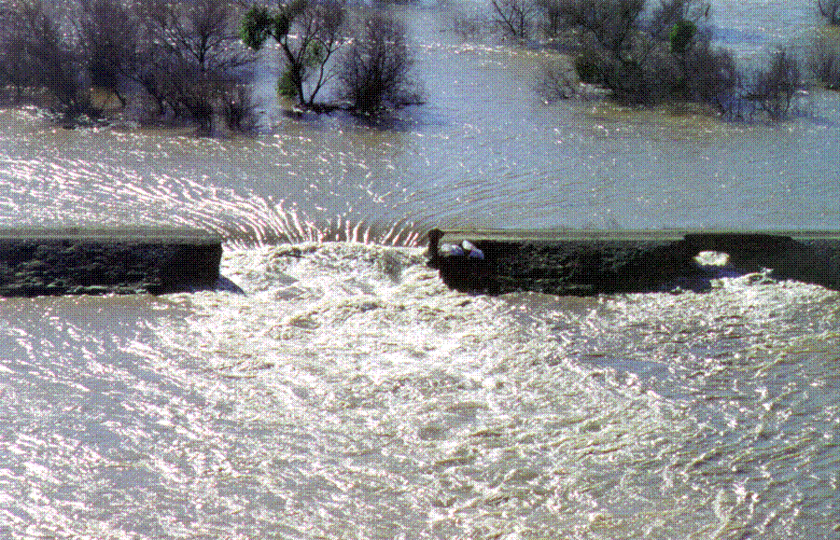
Galgamento e Ruptura de Dique
Feather River, 1997 Flood
Notes:
Levee overtopping and breaching can be analyzed within HEC-RAS by modeling the levee as a lateral structure. When modeling a levee with a lateral structure, the area behind the levee should not be included in the cross section data of the main river. The cross sections should stop at the bottom of the levee. The lateral structure (levee) can be connected to a storage area or another river reach. The strategy for modeling the area behind the levee will depend upon what will happen to the water if the levee overtops or breaches. If the water going over or through the levee will pond, then a storage area would be more appropriate for modeling the area behind the levee. If the water will continue to flow in the downstream direction, and possibly join back into the main river, then it would be more appropriate to model that area as a separate river reach.

Slide 36
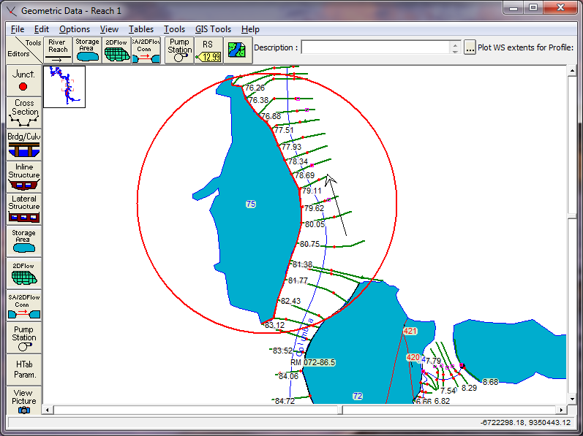
Dique – Definido como Estrutura Lateral
Notes:
The user defines the levee by entering a series of station and elevation points that represent the top of levee profile. This station and elevation data is then used as a weir profile for calculating the amount of water going over top of the levee. An example levee entered as a lateral structure is shown in the Figure above.

Slide 37
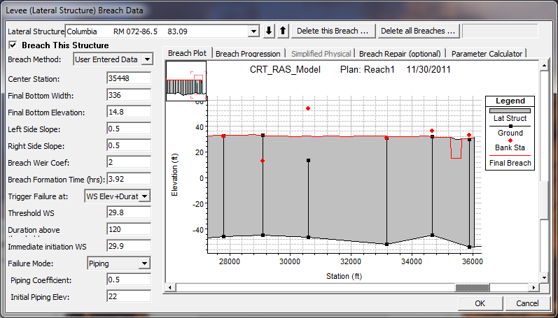
Dados sobre Ruptura de Dique
Notes:
This option is very similar to the Dam Break option described previously. The only difference is that the breaching is performed on a levee. The options and data entered to describe the breach is the same as a Dam Break.
In order to use this option, the user must first define the levee as a lateral weir within HEC-RAS. The lateral weir profile is used to describe the top of the levee along the stream both at and between the cross sections. Second, a weir coefficient is entered for calculating the flow that may go overtop of the levee if the water surface gets high enough. Entering breach data for the levee can be accomplished from the lateral weir editor or from the Levee (lateral weir) Breach option from the unsteady flow simulation window. The levee breaching data is stored as part of the unsteady flow plan file, just as it is for a dam break. When the levee breach option is selected, a breach editor will appear as shown above.
The information entered in the fields is the same as for a Dam Break.

Slide 38
Ruptura de Dique: Plotagem de Perfil
Notes:
The plot above is an example profile animation of a levee breach.

Slide 39
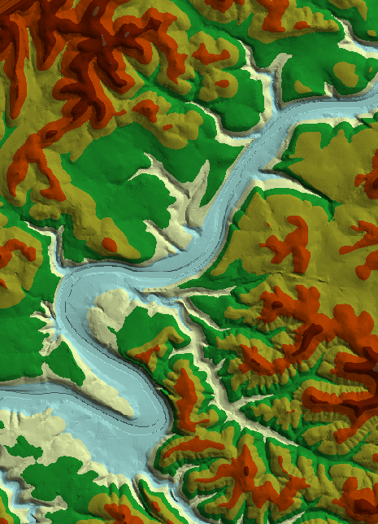
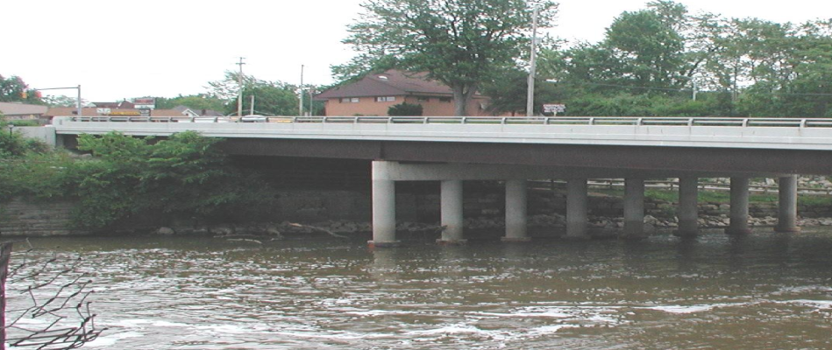
Aquisição e Processamento de Dados
Dados sobre terreno
Fotografias aéreas
Estruturas hidráulicas

Slide 40
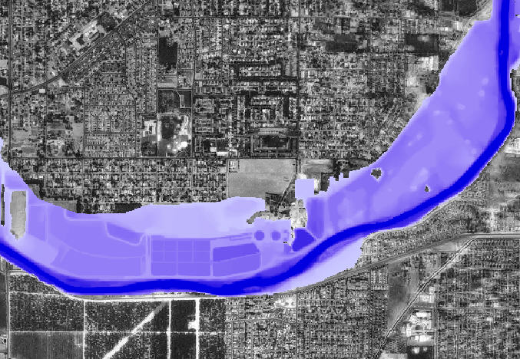
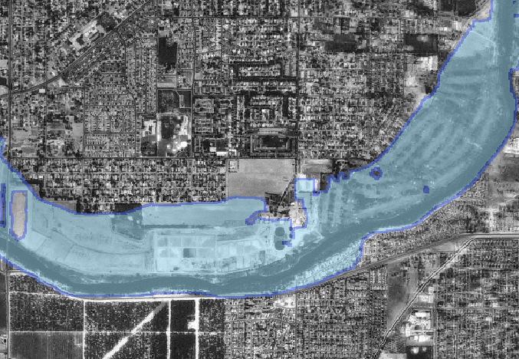
HEC-GeoRAS / Mapeamento de Planície de Inundação
Profundidade
Limites
Notes:
The results of the floodplain mapping step may be used with other layers to assist the hydraulic engineer in improving the hydraulic model. After examination of the floodplain boundary and inundation depths, hydraulic properties can be modified and refined.
With the publishing of the final product it may be used for multiple purposes. Flood damage reduction studies, flood warning and response preparedness, identification and impact to environmental areas. There are endless uses.

Slide 41
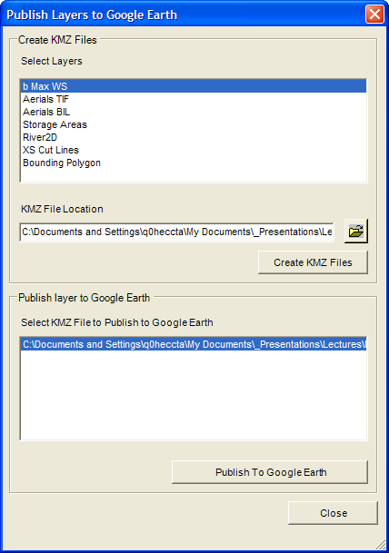
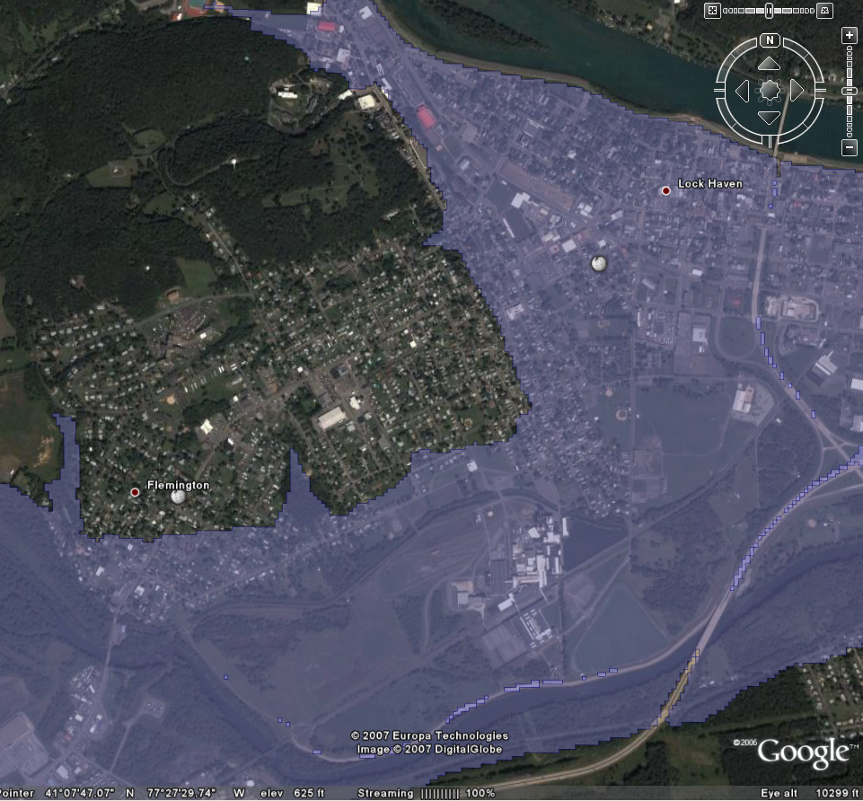
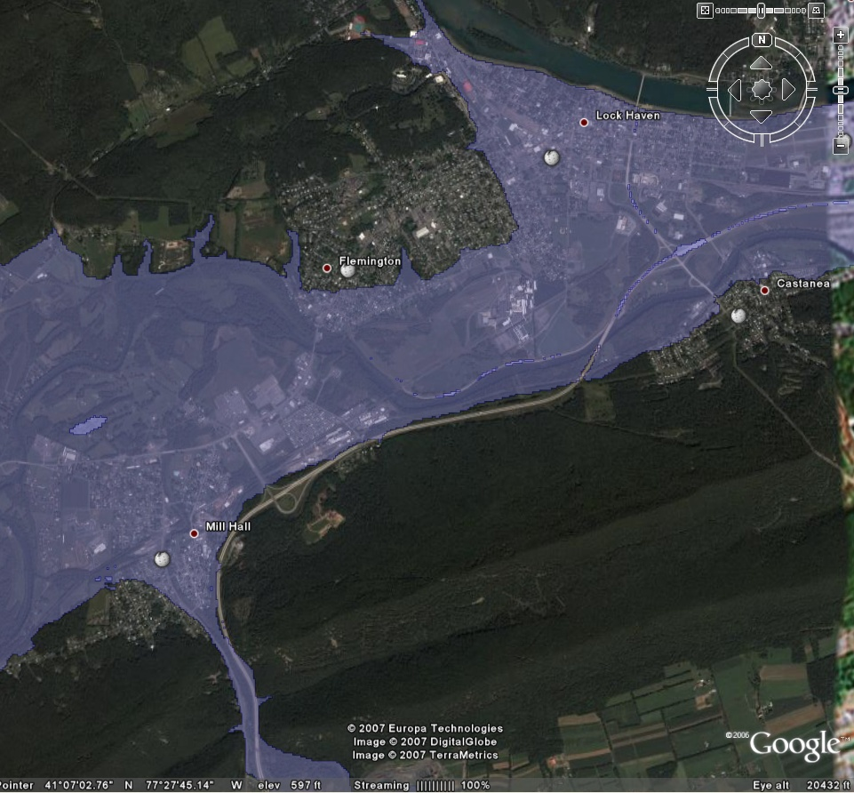
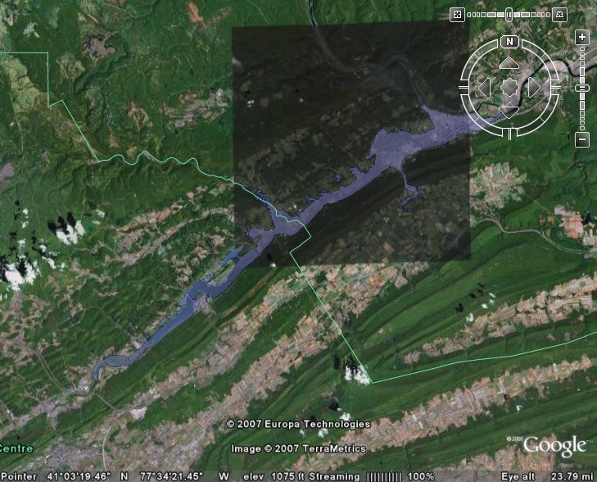
Mapeamento com Google Earth
Notes:
The Publishing to Google Earth tool allows you to choose the floodplain boundary (or other features) to export. A KMZ file is created, which is Google Earth’s native format.
Once the KMZ file is created, you can lauch Google Earth from GeoRAS and the feature will be displayed… Pretty Cool.
Not all color schemes in ArcGIS will be supported in the export process. You will probably need to adjust them using the palette options available in Google Earth.
This process projects the dataset in the Lattitude/Longitude coordinate system that Google Earth uses and will not work on Raster datasets.

Slide 42
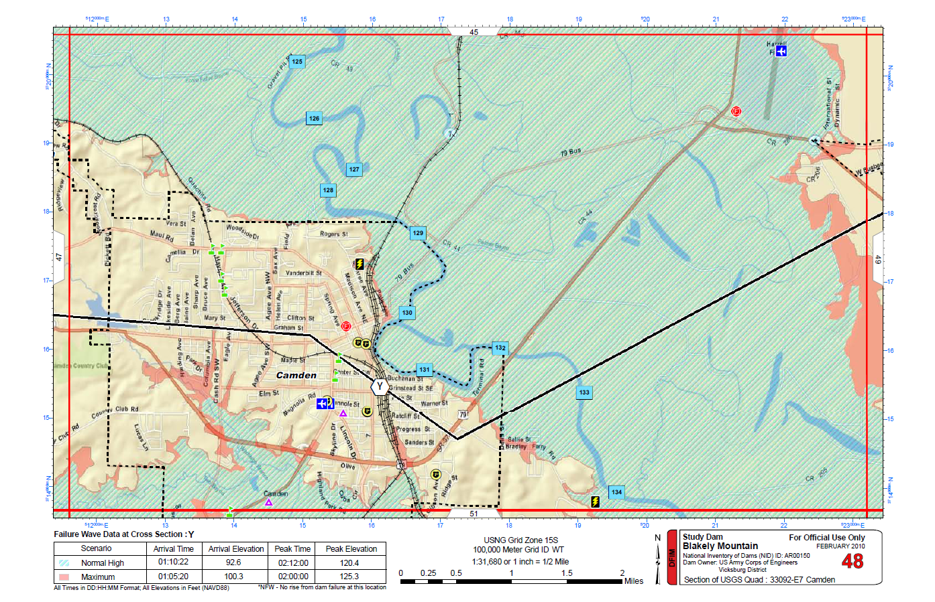
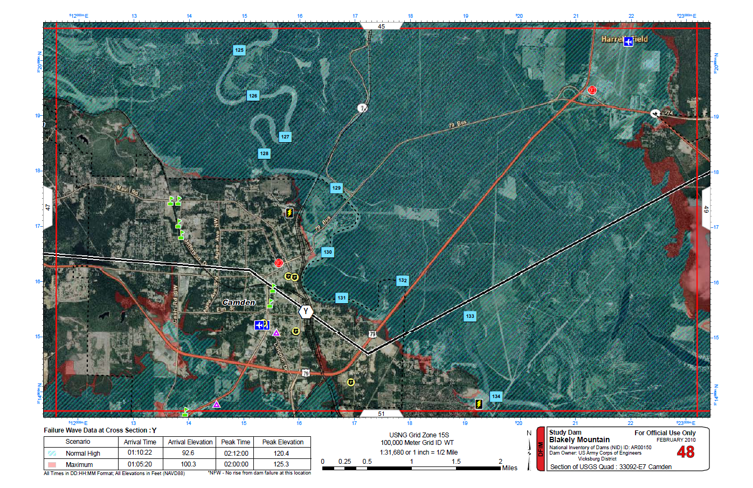
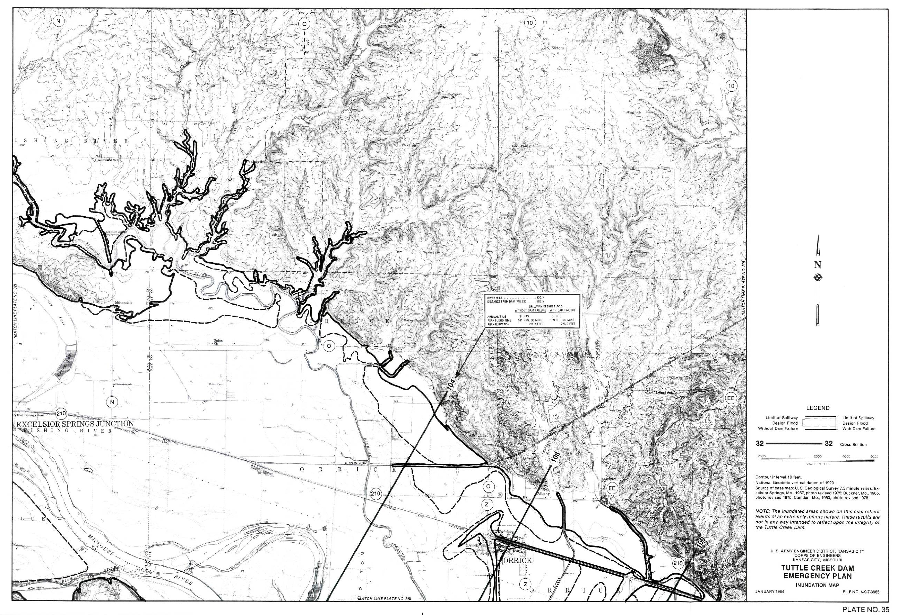
Map Sheets
Notes:
Shows the old way of doing things and the new way.

Slide 43
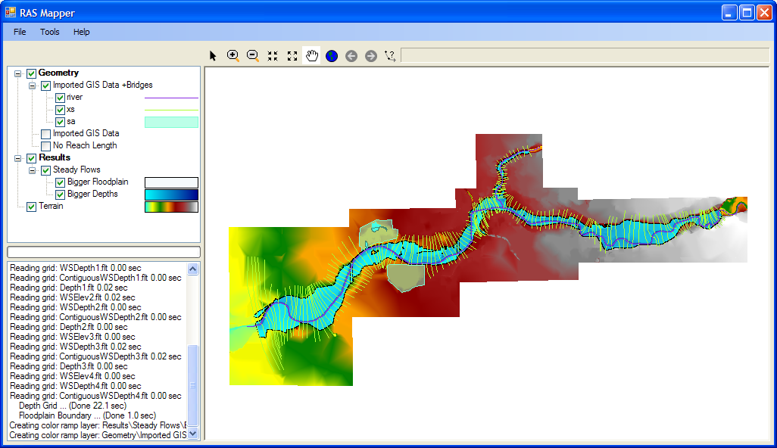
“RAS Mapper”
Notes:
Here’s the RAS Mapper. It is comprised of a Layers panel, Status panel, and Display window. Note that data is organized for you by Geometry and Results based on how you have your data setup in your RAS model.

Slide 44
Exemplo de Animação
Notes:
HEC-RAS 2-d floodplain modeling sample. Muncie Indiana

Slide 45
Exemplo de Animação
Notes:
HEC-RAS 2-d floodplain modeling sample. St. Paul, Minnesota

Slide 46
Exemplo de Animação
Notes:
Flyover is generated from RAS data and loacl inventory data. It visualizes the areas that could be flooded under varying flood events. The Blue represents a 1% and the red is a larger flood (don’t know what). The largest population is at the downstrewam end and it ends up showing a school being flooded. This helps someone visualize what would happen at a location under this flood condition. If you say there are 1,000 cms in the river people can’t visualize what that really means. By showing that the school would be under 3m of water (or some value) that flow rate can be equated to an elevation that would be recognizable to basically anyone.

Slide 47
Vazão
Aterro Desmorona
Ruptura total
Tubo de erosão formado entre lago e saída
Tentativa de intervenção
Alerta divulgado
Decisão: Barragem vai falhar
Lançado modo de falha
Fluxo lamaçento observado
Após a divulgação do alerta – Período importante para estimar consequências –
ANÁLISE DE SENSIBILIDADE
Tempo
Notes:
Warning Issuance Offset - Important time for consequence estimate – SENSITIVITY ANALYSIS
Até a divulgação do alerta – Período importante para estimar consequências – ANÁLISE DE SENSIBILIDADE
Simulates the steps of an impending dam failure.

Slide 48
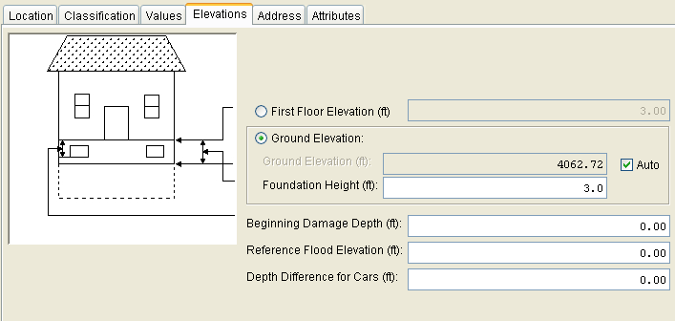
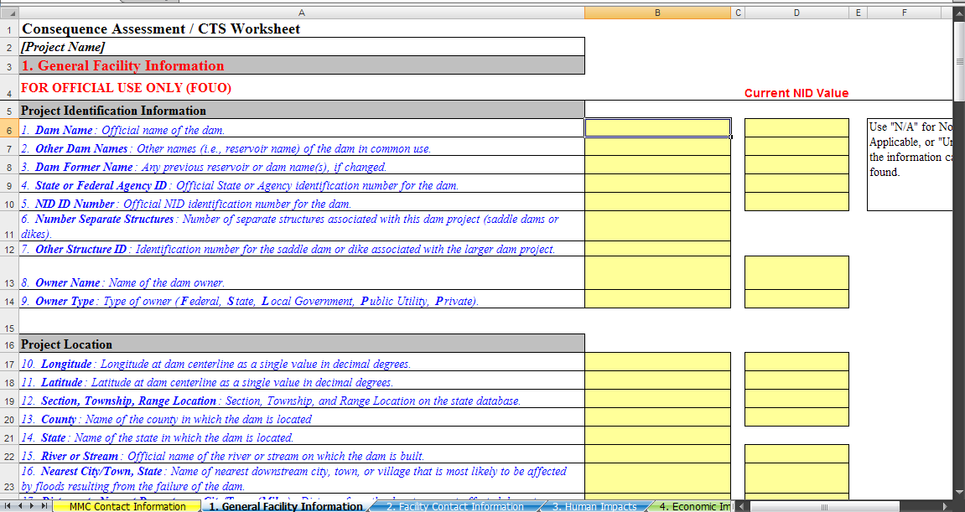
Consequências em Números
Base de Dados sobre Consequências
Impact Area Name | Failure Event | Total Urban Damages ($1000) | Total Damages ($1000) | Total Number of Structures Flooded | Total Population Impacted | Total Population Over 65 Impacted
Nevada County | 10% | 2,452 | 2,452 | 18 | 24 | 0
 | FCE | 7,164 | 7,164 | 40 | 83 | 3
 | DFE | 9,411 | 9,411 | 59 | 116 | 5
Storey County | 10% | 1,547 | 1,547 | 100 | 45 | 84
 | FCE | 11,790 | 11,790 | 206 | 332 | 111
 | DFE | 17,207 | 17,207 | 245 | 409 | 127
Washoe County | 10% | 89,587 | 89,587 | 1,545 | 955 | 360
 | FCE | 922,063 | 922,063 | 6,681 | 8,961 | 1,863
 | DFE | 2,348,758 | 2,348,758 | 13,387 | 28,230 | 4,353

Slide 49
LEARNING OBJECTIVES
Using the course manual, references and lecture notes, the student will be able to understand hydrologic and hydraulic aspects of dam safety program. After this presentation, the student will be familiar with concepts, terminology and inter-relationships between hydrologic, hydraulic and water management considerations essential in the engineering analysis associated with the administration of the USACE Dam Safety program.
PERGUNTAS

